Slide 2

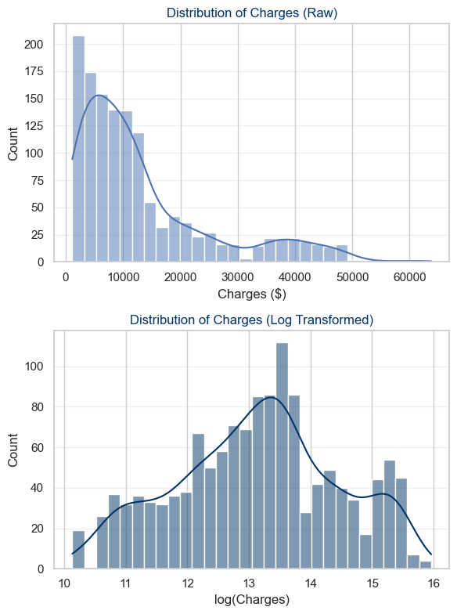

Univariate Exploratory Data Analysis
Predictor
Target

